Slide 1

ENHANCING RESUME PARSING SYSTEM WITH MACHINE LEARNING
P. Vedha vyas(192210504) M. Rohit(192211415)

Slide 2
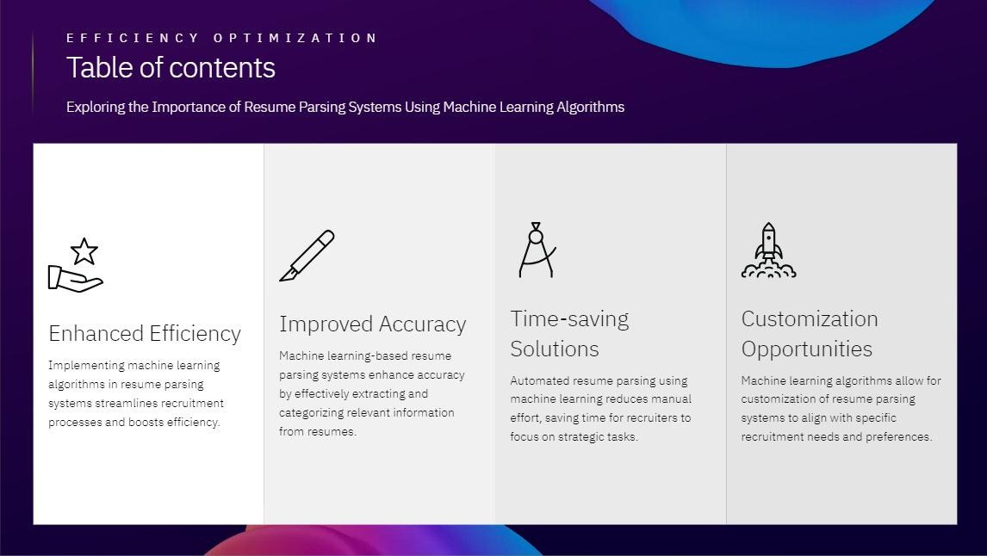

Slide 3
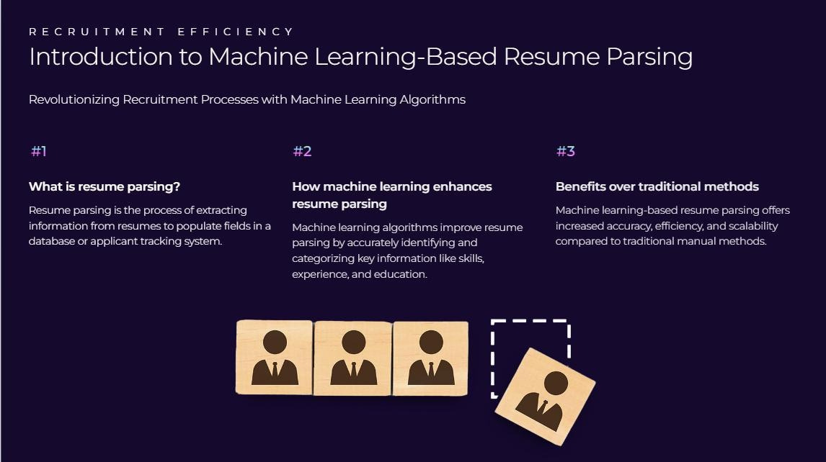

Slide 4
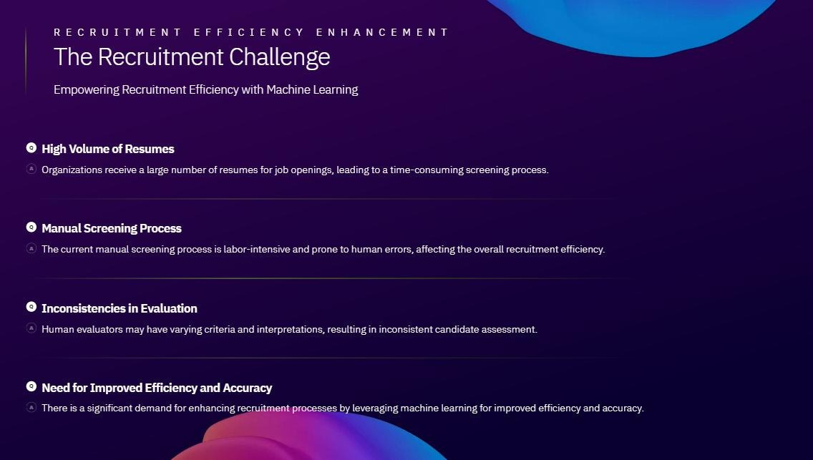

Slide 5
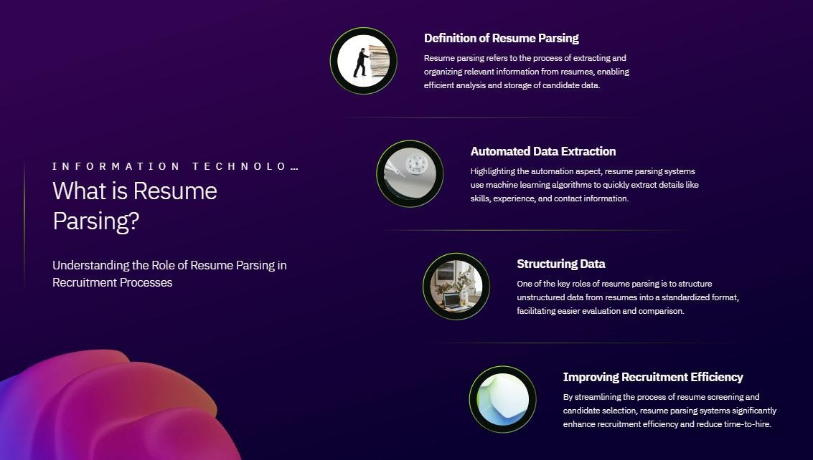

Slide 6
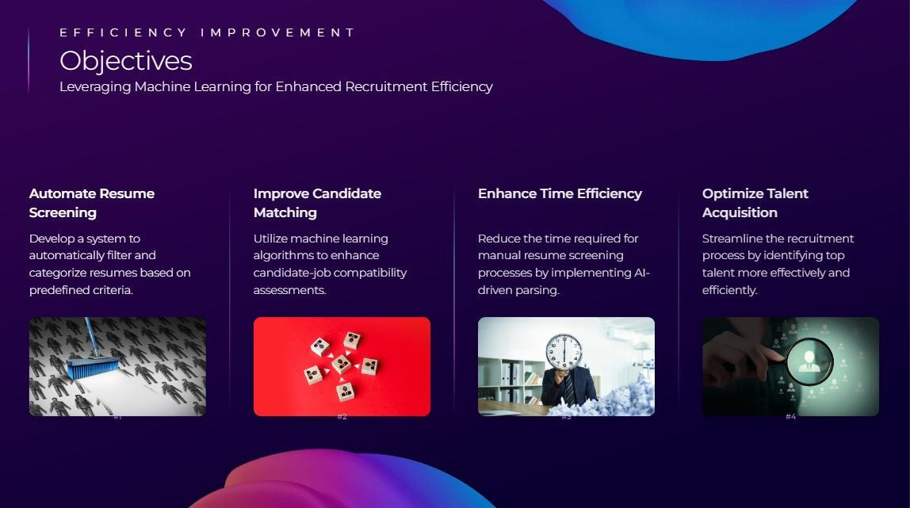

Slide 7
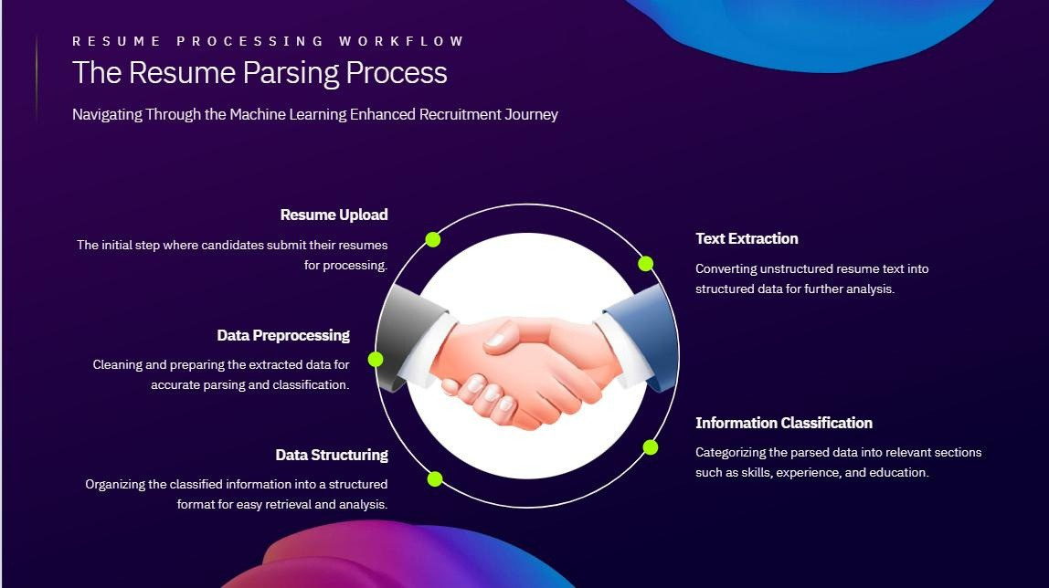

Slide 8
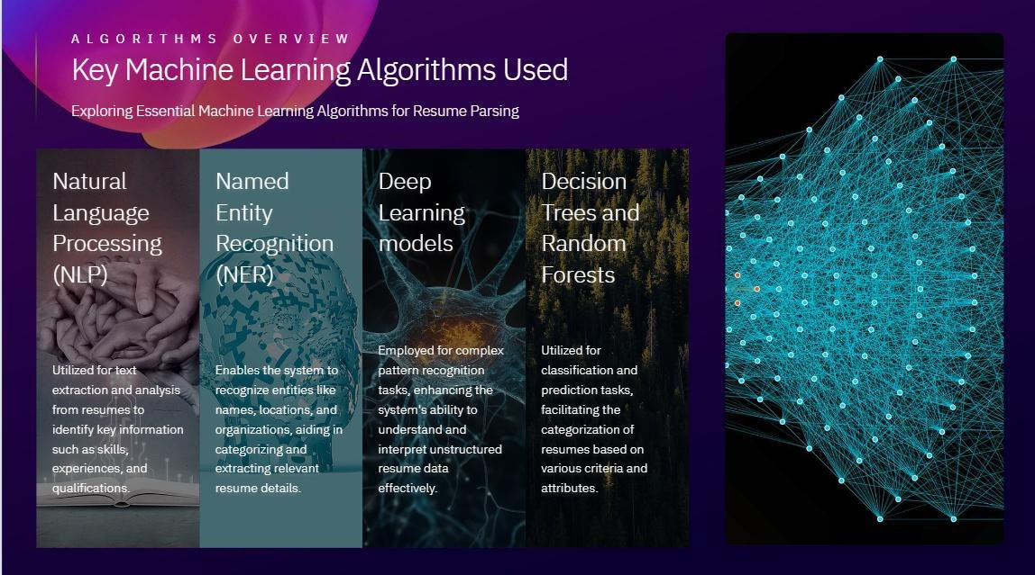

Slide 9
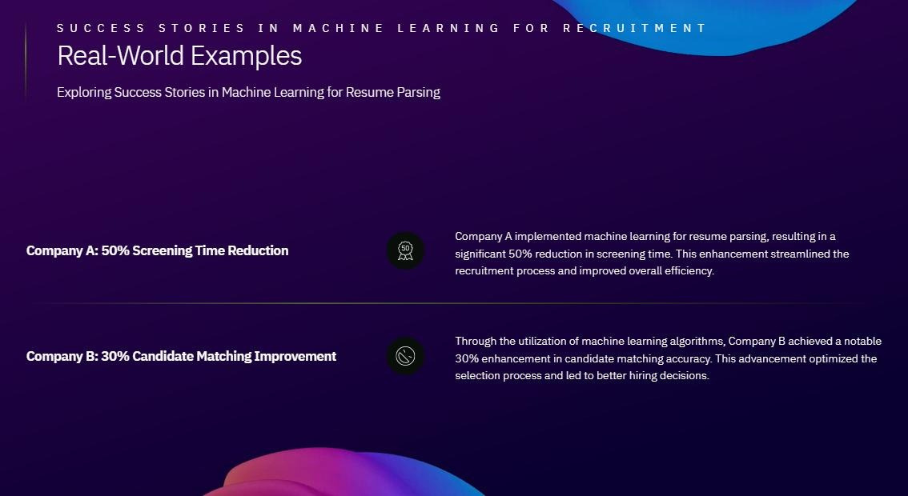

Slide 10


Slide 11


Slide 12
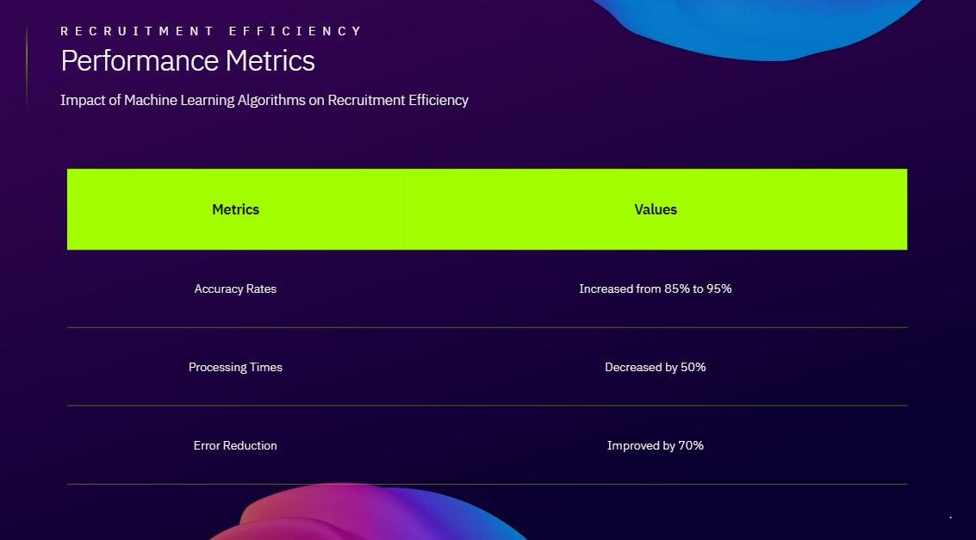

Slide 13

Implementation
- Provide a pseudocode snippet or a flowchart that illustrates the algorithm in action. This helps visualize
how the algorithm processes data from resumes to match job requirements.
Algorithm Overview:
- Preprocessing: Tokenization, cleaning, and normalization of resume text.
- Feature Extraction: Identification of key features such as skills, experience, and education. - Classification: Matching extracted features with job requirements using a scoring or similarity function.
Mathematical Formulation:
- Let \( R = \{ r_1, r_2, …, r_n \} \) be the set of resumes.
- Let \( F = \{ f_1, f_2, …, f_m \} \) be the set of extracted features. - Let \( J = \{ j_1, j_2, …, j_k \} \) be the set of job requirements.
- Classification function \( C(r_i, j_i) \) maps resume \( r_i \) to job requirement \( j_i \).
Algorithm Efficiency:
- Time complexity: \( O(n \cdot m) \) for feature extraction, \( O(k \cdot n) \) for classification. - Space complexity: \( O(n + m + k) \) for storing resumes, features, and job requirements.

Slide 14


Slide 15
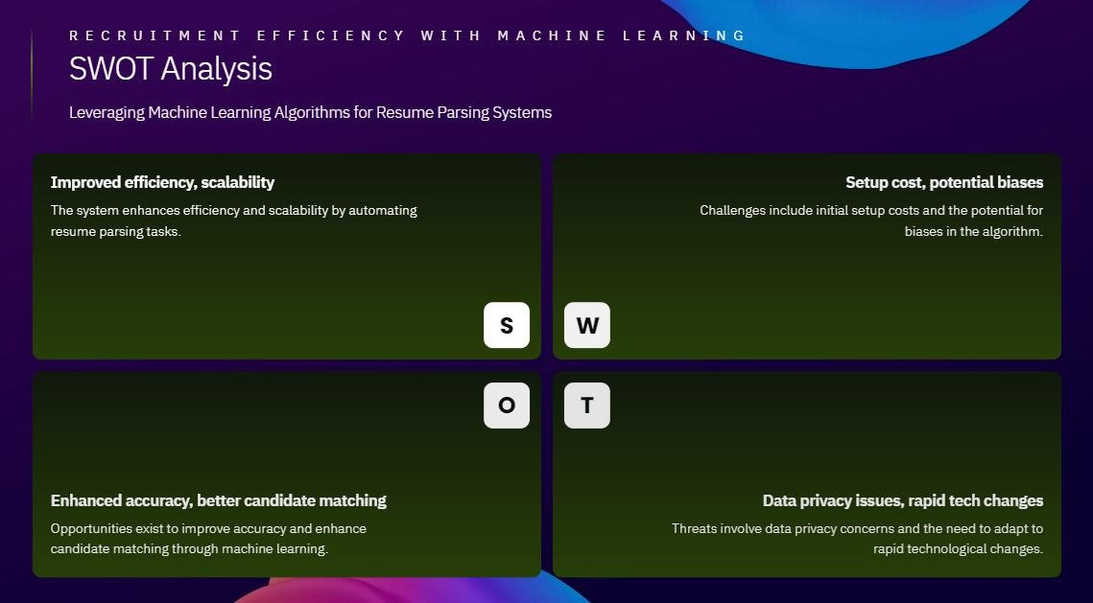

Slide 16
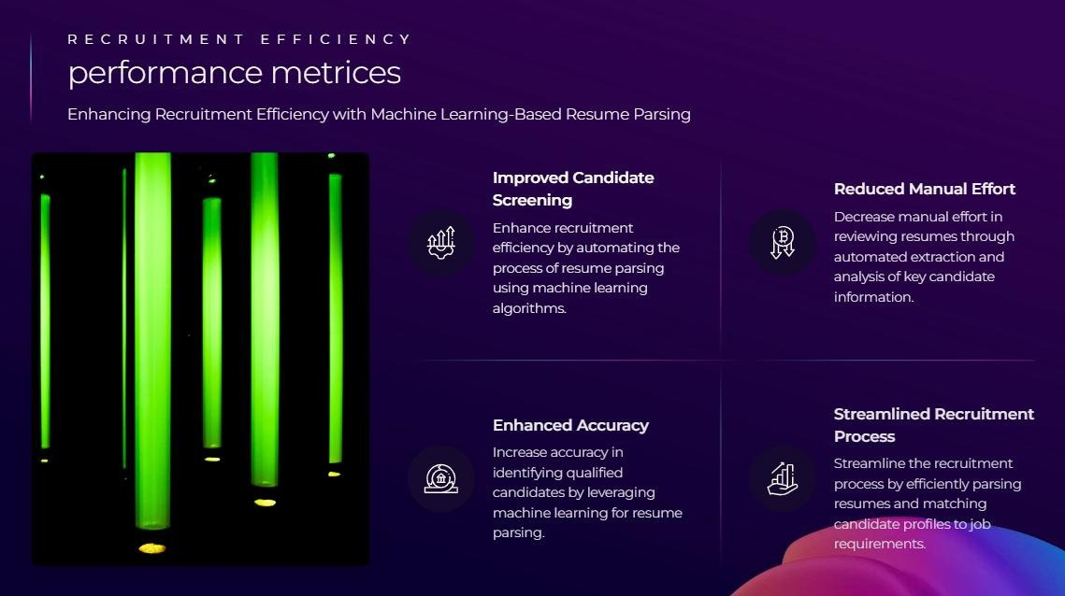

Slide 17
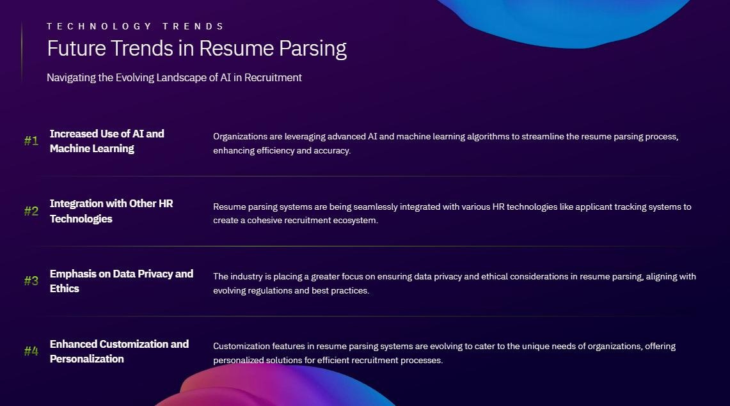

Slide 18


Slide 19
